Slide 1
Lecture Three Memory and I/O Interface

Slide 2
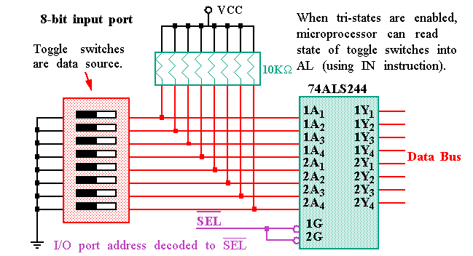
Basic Input Interfaces

Slide 3
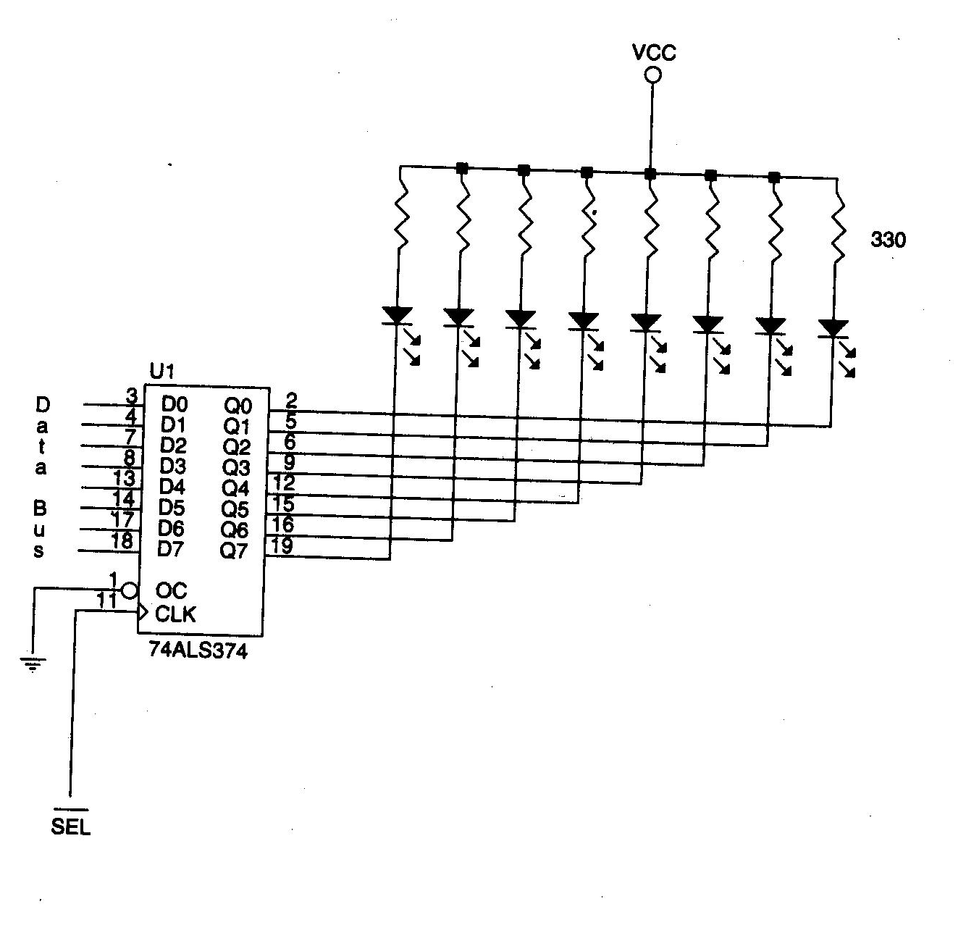
Basic output interfaces
The speed of microprocessor is much larger than the speed of output devices.
To synchronize their speed
a latch is used. The latch
makes a delay of the signal
generated for the output devices.

Slide 4
Handshaking
♪ Many I/O devices accept or release information at a much slower rate than the microprocessor. Another method of I/O control is called handshaking or polling, synchronizes the I/O devices with the microprocessor.
♪ An example device that requires handshaking is a parallel printer that prints 100 characters per second (CPS). It is obvious that the microprocessor can definitely send more than 100 CPS to the printer, so a way to slow the microprocessor down to match speeds with the printer must be developed.

Slide 5
Isolated I/O and Memory‑Mapped I/O
Isolated I/O:
The most common I/O transfer technique used in the Intel microprocessor‑based system is isolated I/O. The term isolated describes how the I/O locations are isolated from the memory system in a separate I/O address space.
Memory‑Mapped I/O:
A memory‑mapped I/O device is treated as a memory location in the memory map. Unlike isolated I/O, memory‑mapped I/O does not use the IN, INS, OUT, or OUTS instructions. Instead, it uses any instruction that transfers data between the microprocessor and memory.

Slide 6
Difference between Isolated I/O and memory mapped I/O
Isolated I/O | Memory Mapped I/O
The I/O locations are isolated from memory system in a separated I/O address space. | Full memory can’t be expanded since a portion is used as I/O map.
Memory can be expanded to its full size without using any of memory space for I/O devices. | Full memory can’t be expanded since a portion is used as I/O map.
Data transfer between microprocessor and I/O requires IN, INS, OUT and OUTS instructions. | No such instruction is required for transferring data.
Expanded amount of memory. | Reduced amount of memory.

Slide 7
Address Decoding
Since a computer system involves simply a microprocessor, I/O devices and a memory; we need to interface the microprocessor with either I/O or memory.
Therefore, we have to decode address only for either I/O devices or memory.
Thus we have either memory address decoding or I/O address decoding.

Slide 8
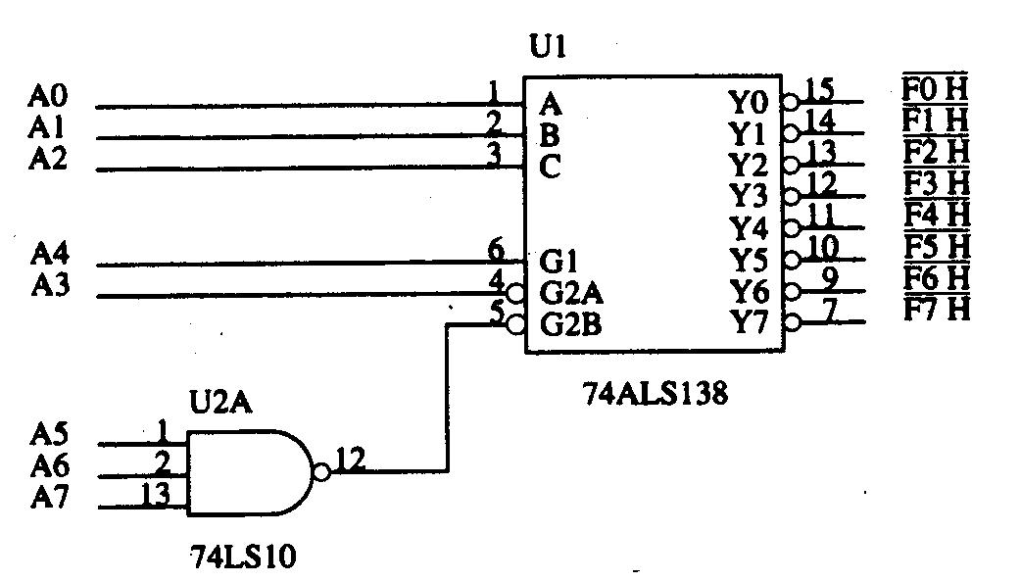
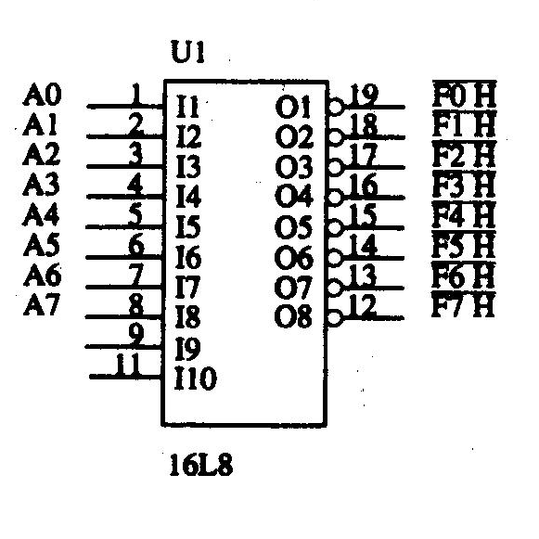
As mentioned, the fixed I/O instruction uses an 8‑bit I/O port address that appears on A15‑A0 as 0000H‑00FFH. If a system will never contain more than 256 I/O devices, we often decode only address connections A7‑A0 for an 8‑bit I/O port address. Thus, we ignore address connections A15‑ A8.
Decoding 8‑bit I/O Addresses
Fig: 8 port I/O decoder using 74138
Fig: 8 port I/O decoder using PAL16L8

Slide 9
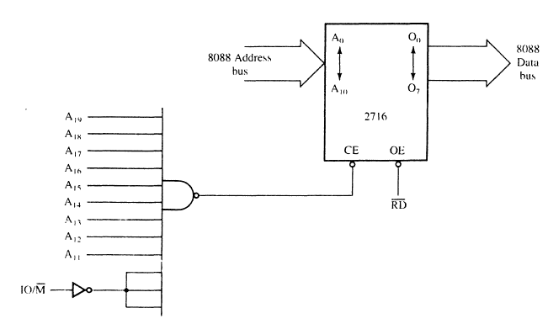
Memory Decoding: A simple NAND gate Decoder
A₁₉A₁₈A₁₇A₁₆A₁₅A₁₄A₁₃A₁₂A₁₁A₁₀A₉A₈A₇A₆A₅A₄A₃A₂A₁A₀
1 1 1 1 1 1 1 1 1 X X X X X X X X X X X
1 1 1 1 1 1 1 1 1 0 0 0 0 0 0 0 0 0 0 0
1 1 1 1 1 1 1 1 1 1 1 1 1 1 1 1 1 1 1 1
Therfore, Starting Address FF800 H
Ending Address FFFFF H

